Slide 1

SMART IRRIGATION SYSTEM
Group Code: A-3
Team Members:
2019250 Mr. Mohammed Saad Khan
2019225 Mr. Malik Munib
2019178 Mr. Hasnain Ali
Supervisor
Dr. Farhan Khan Co-supervisor
Ms. Dur-e-Zehra
Faculty of Computer Sciences and Engineering Ghulam Ishaq Khan Institute of Engineering Sciences and Technology, Pakistan

Slide 2
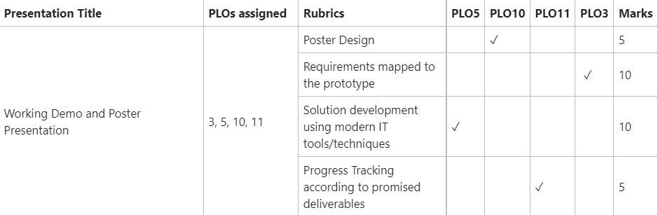
RUBRICS TABLE

Slide 3
A Quick Recap
The interfacing of sensors with Arduino and their calibration.
Data acquisition from sensors.
Wireless transmission of the data using GSM900A.
Displaying the real-time data on thingspeak in graph for visualization. Also available in CSV form.
PCB design layout for the project using EasyEda software.
Mechanical design for the RC servo and ½ inch ball valve using solidworks.(in progress)

Slide 4
BILL OF MATERIALS
S no. | Components | Price(Rs.) | Quantity
1 | DS3225 25 KG 6-volt RC servo | 2850 | 1
2 | SIM900A GSM module | 2500 | 1
3 | 12 V 5 A power supply | 750 | 1
4 | Step down 5 A XL4015 buck converter | 250 | 1
5 | DHT22 temperature and humidity sensor | 800 | 1
6 | Arduino UNO R3 SMD board kit with usb cable | 1250 | 1
7 | Rain Drop detection sensor module | 150 | 1
8 | Soil moisture sensor for arduino | 180 | 1
 | Total Price: | 8730

Slide 5
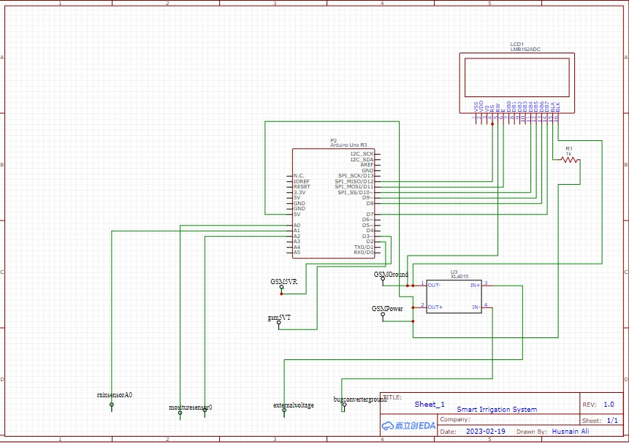
Project Schematics

Slide 6
Water Resource Management
Initial plan was to use MOSFET driver IRF520 to drive proportional solenoid valve for water flow control.
We are using ½ inch ball valve and 25 kg RC servo with a mechanical assembly of 3d printed parts.
Trial and error method.
The 3d design is still a work in progress.

Slide 7
Problem with proportional solenoid valve…
Proportional solenoid valve is not easy to acquire as it is quite expensive so it is not a viable solution to the problem.
One proportional solenoid valve costs approximately anywhere between 250-600 usd for a normal grade valve to industrial grade valve.
Approximately, 65,300 to 156,920 pkr which is out of reach for the average person.
Also, the valves are not available in required size which is a problem.

Slide 8
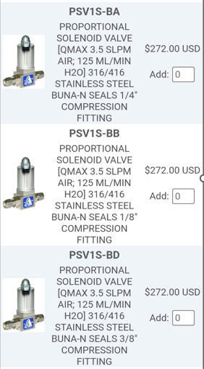
Price Description

Slide 9
Substitute for proportional solenoid valve
We are using a mechanical assembly of 3d printed parts for holding the ball valve and RC servo in place.
This assembly helps to perform the task of water flow control according to the requirement.
We used solidworks to design the components.
There were multiple mechanical designs under consideration for this purpose.
These are briefly discussed below.

Slide 10
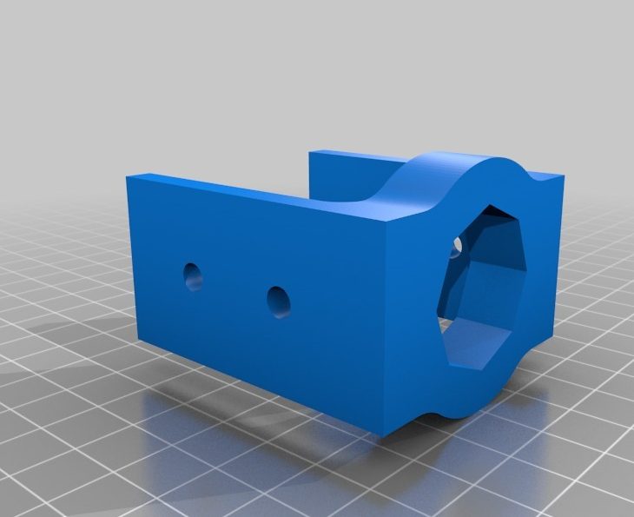
Valve mount

Slide 11
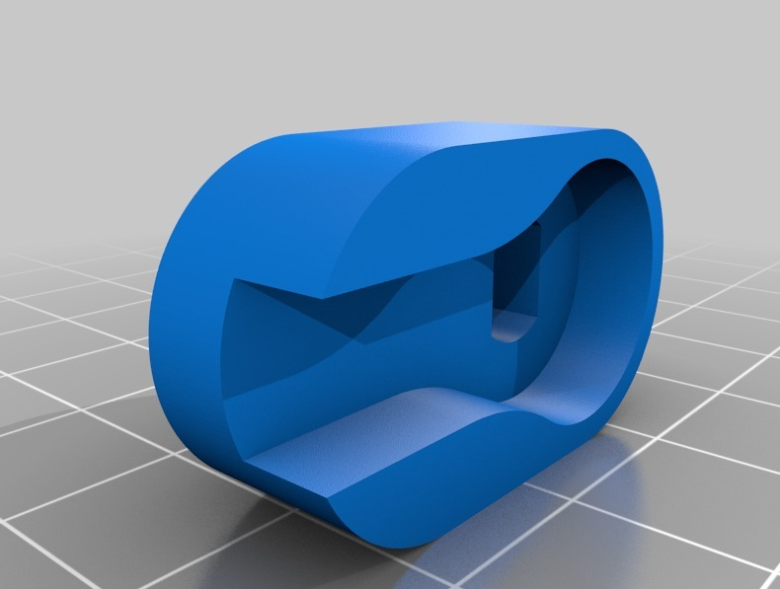
Shaft Adapter

Slide 12
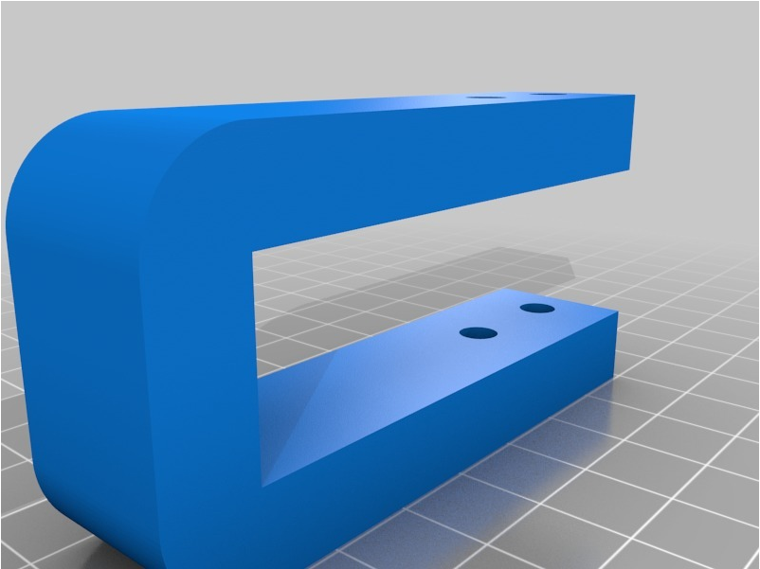
Servo Bracket

Slide 13
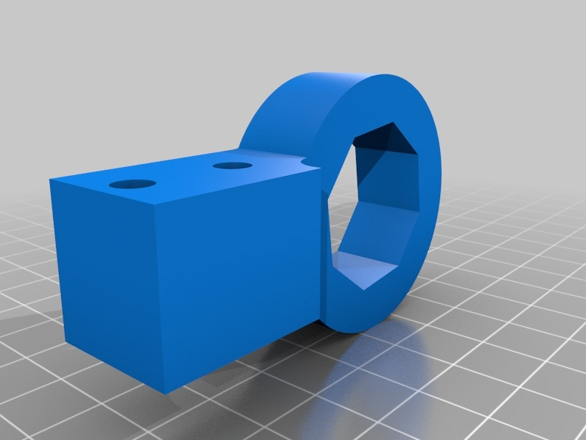
Hex Mount

Slide 14
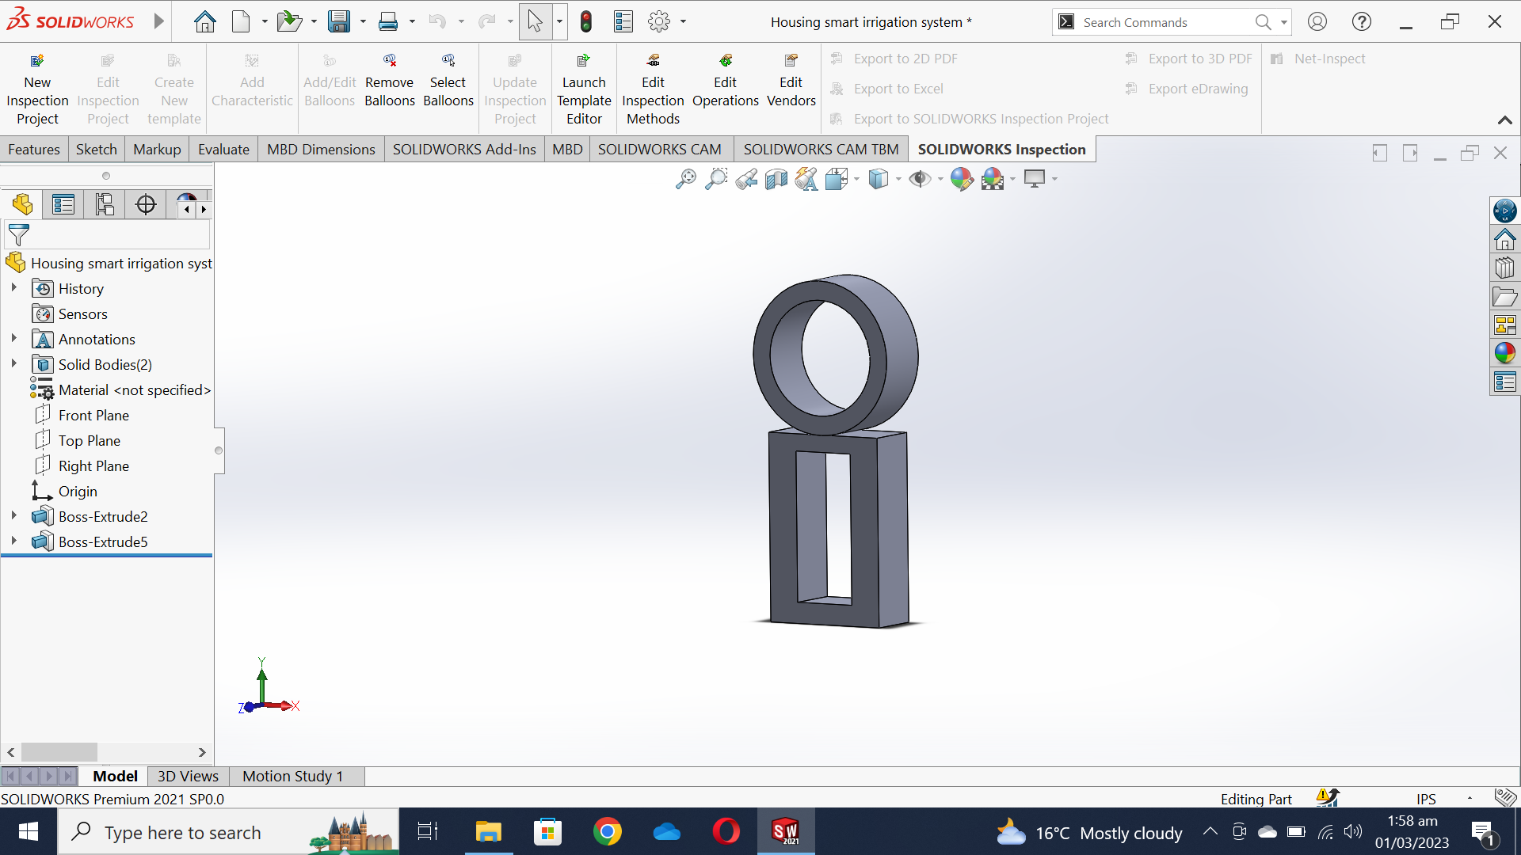
Secondary Design

Slide 15
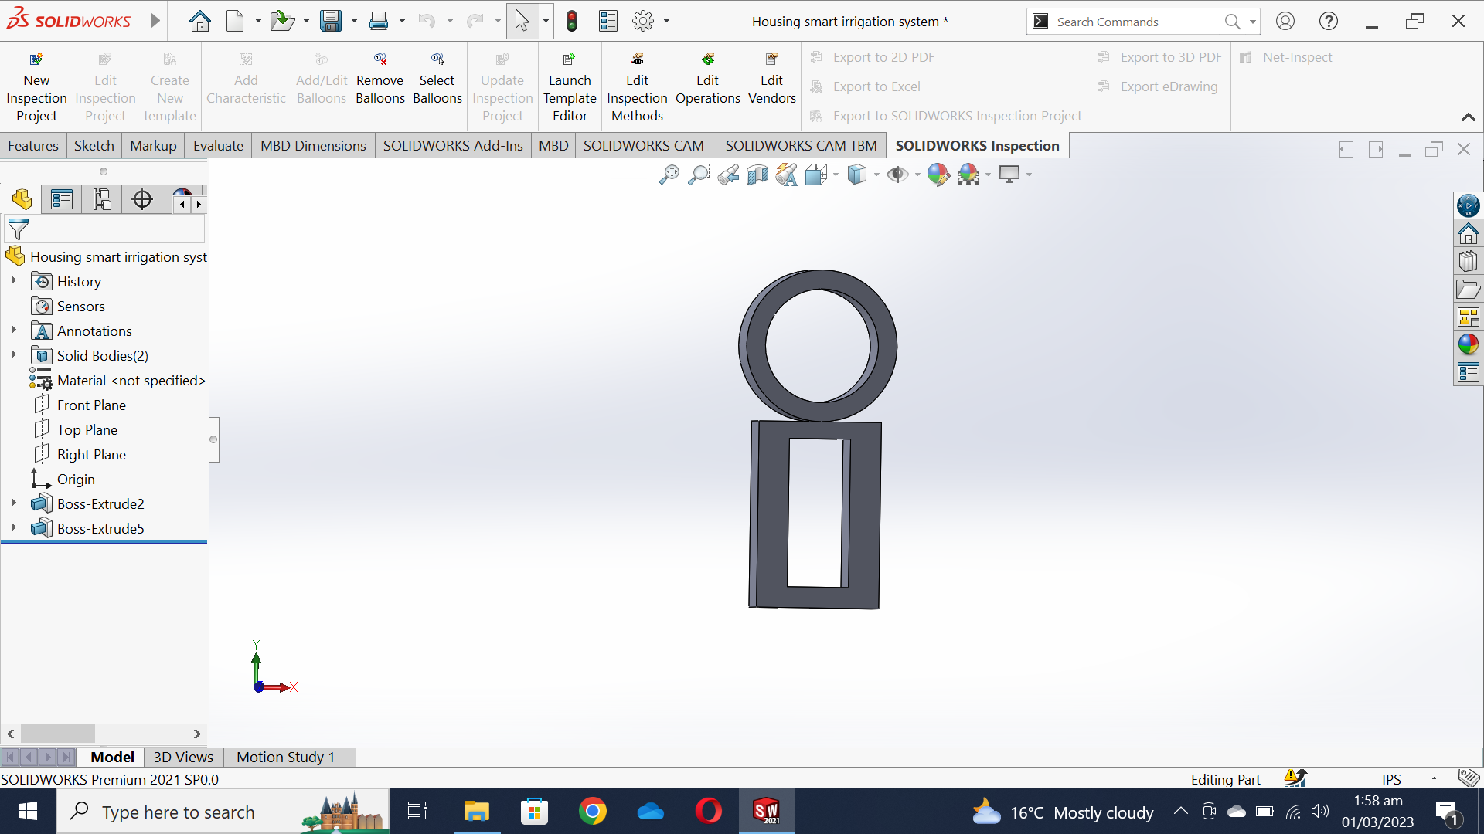
Secondary Design (Front view)

Slide 16
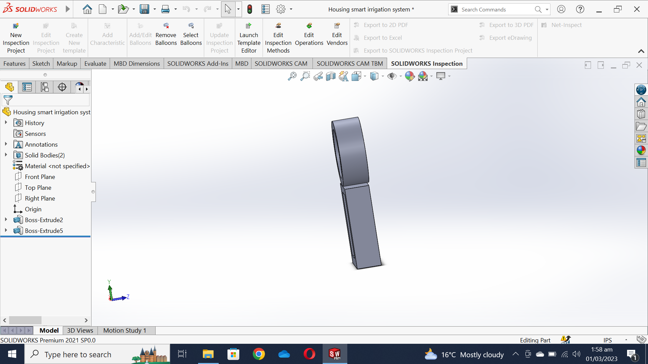
Secondary Design (Side View)

Slide 17
Cost analysis breakdown of valve
Proportional solenoid valve in the market costs around 75,000-100,000 pkr.
On the other hand, the design we propose involving RC servo, ball valve, mechanical parts costs only Rs. 4850.
This includes the cost of 3d printing as well.
Cost efficient.

Slide 18
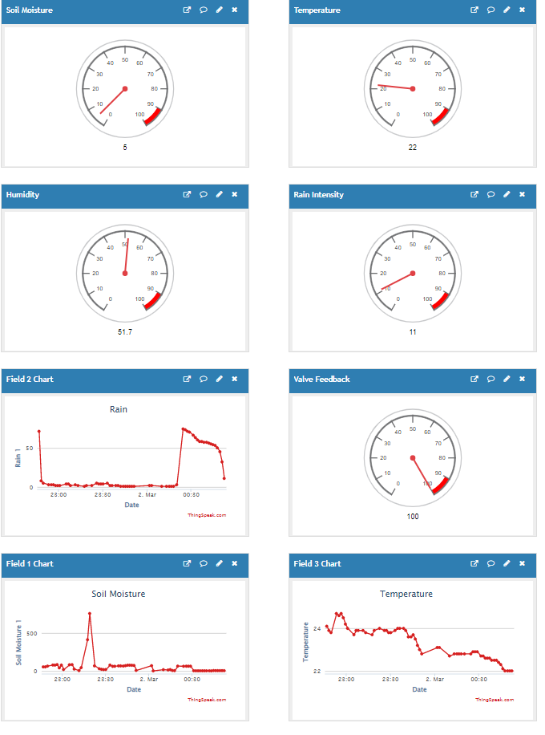
Things Speak

Slide 19

Project Management Tool

